Slide 1
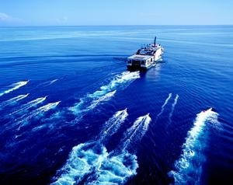
Seismic reflection data
Lecture 2
Dr Rebecca (Becky) Bell and Raul Adriaensen
2nd floor, office 2.37a
rebecca.bell@imperial.ac.uk

Slide 2
Module outline
Day 1 morning- Introduction to seismic data
Lecture 1: Physical principles
Lecture 2: Data acquisition
Lecture 3: Key data processing steps
Day 1 afternoon- Exercises
Exercise 1: Synthetic seismic models
Exercise 2: Viewing “raw” data gathers and conducting NMO corrections and velocity analysis
We will discuss the “solutions” to the exercises during the afternoon sessions (and these will be recorded)

Slide 3
Lecture outline
Objectives of lecture 2:
Learn how seismic reflection surveys are conducted
and what equipment is used
i) Experiment design
ii) Sources and receivers
iii) The ideal wavelet

Slide 4
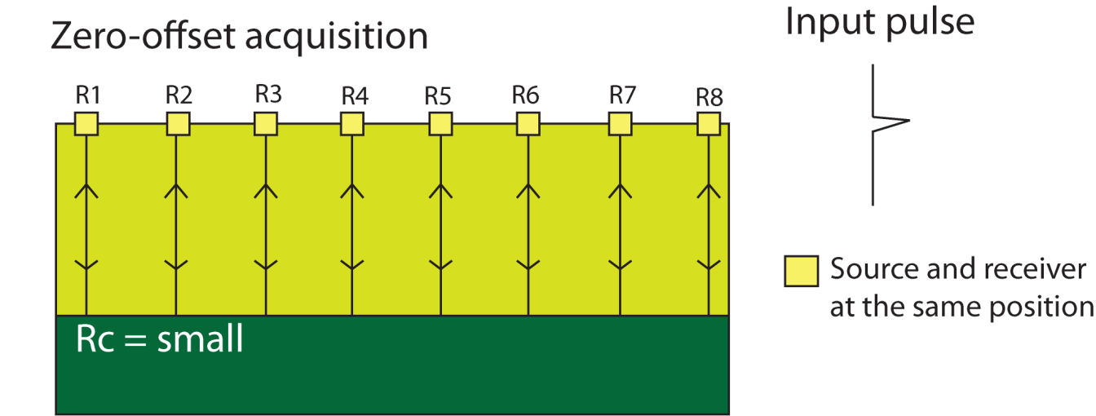
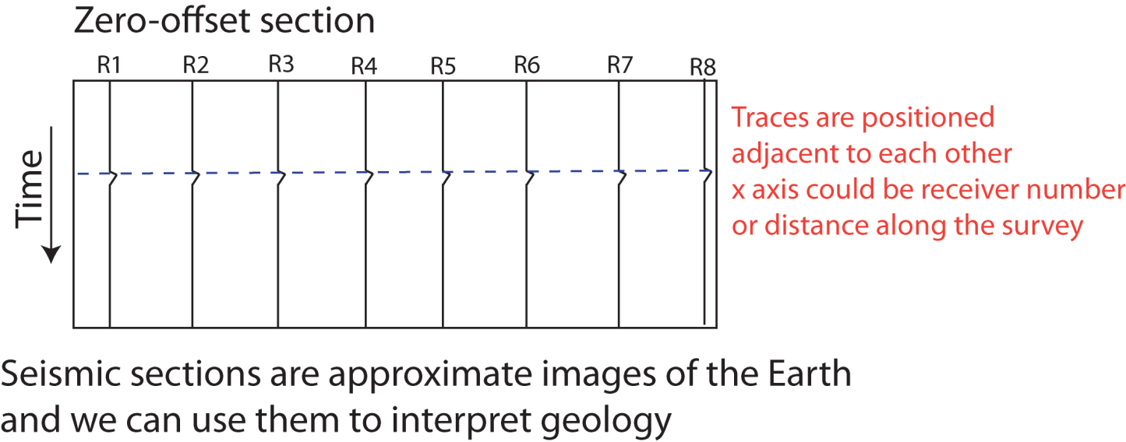
Zero-offset survey
The easiest way to create a SEISMIC SECTION is to conduct a zero-offset survey:
This is what you
will effectively be
doing in exercise 1
Rc = +’ve
Shot
Record
The problem is, reflection coefficients are very small, so the reflections have low amplitude

Slide 5
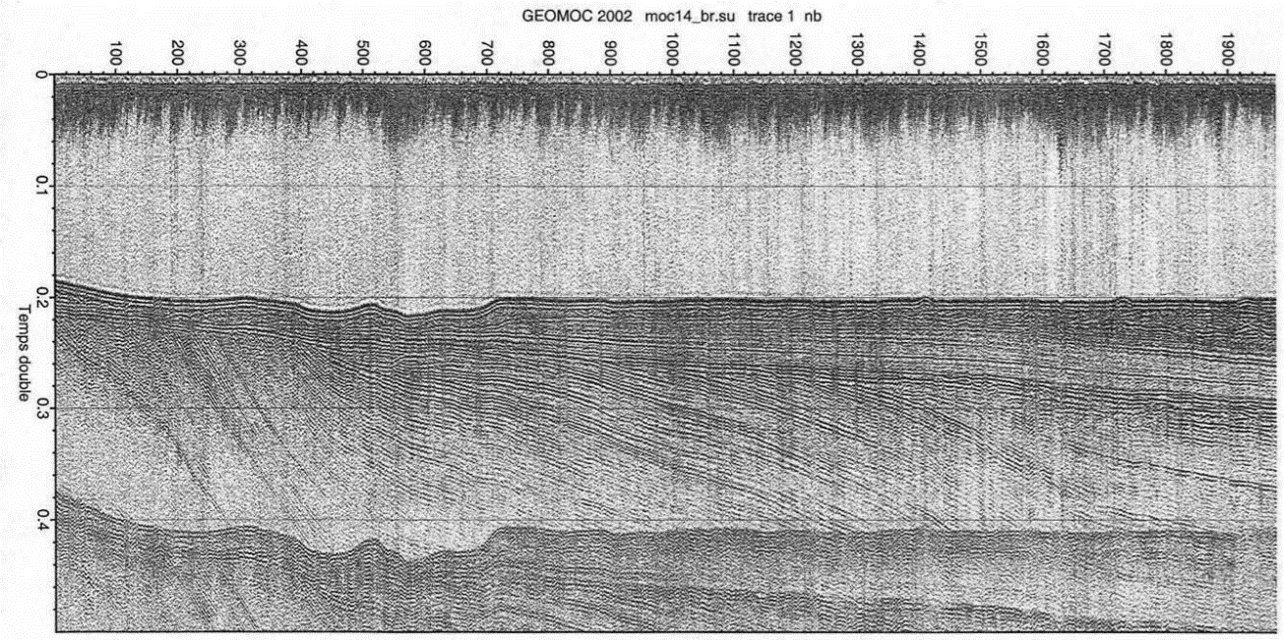
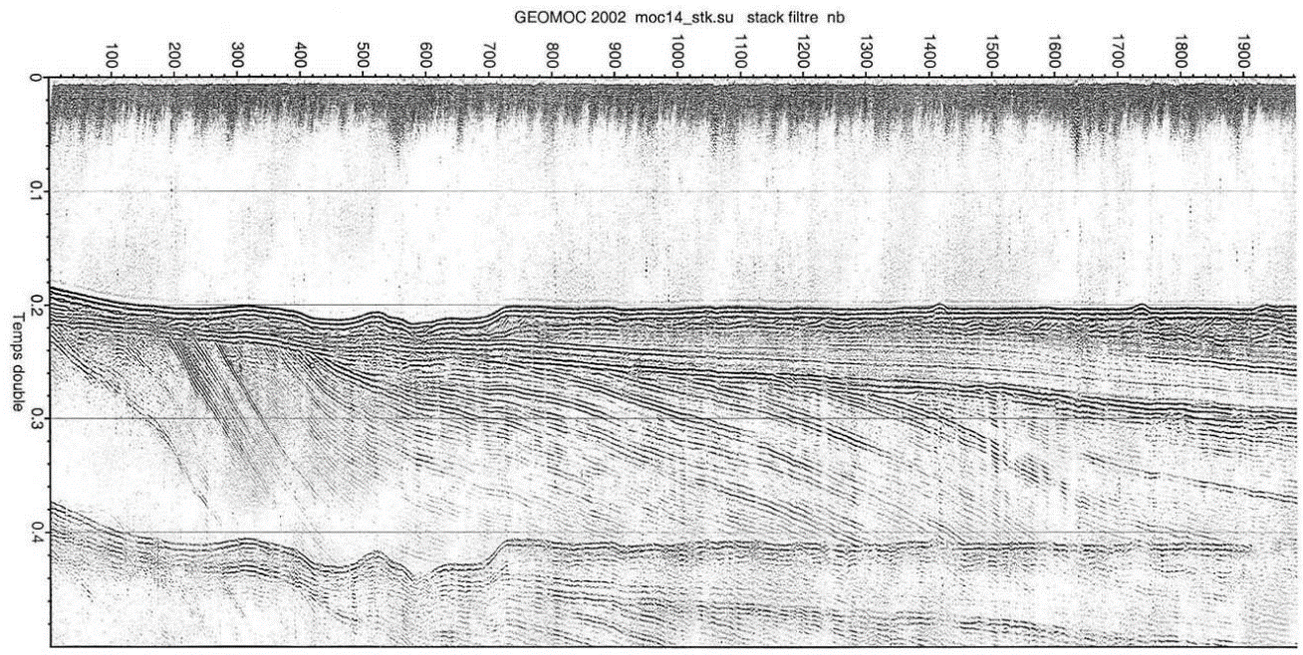
Zero-offset survey
The easiest way to create a SEISMIC SECTION is to conduct a zero-offset survey:
Rc = +’ve
Shot
Record
The problem is, reflection coefficients are very small, so the reflections have low amplitude

Slide 6
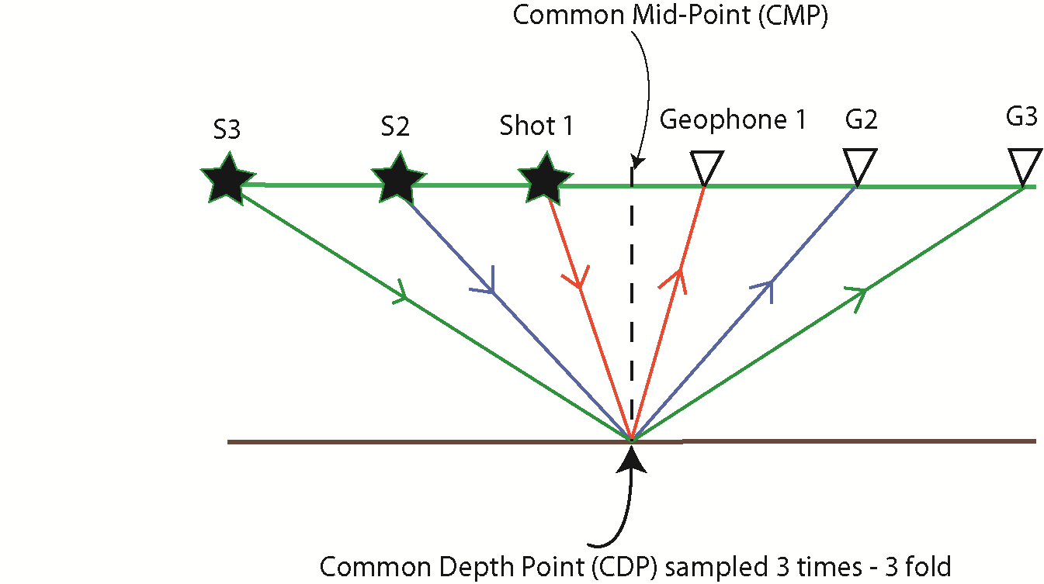
2D Survey geometry
We design seismic surveys so
points in the sub-surface are sampled
more than once
We arrange traces into Common-
Mid-Points (CMPS; also
sometimes called Common
Depth Points, CDPs)- LECTURE 3
This allows us to improve
our signal to noise ratio (S/N)
by stacking traces with the
same CMPs.
This is a key, fundamental idea
behind the seismic reflection
technique

Slide 7
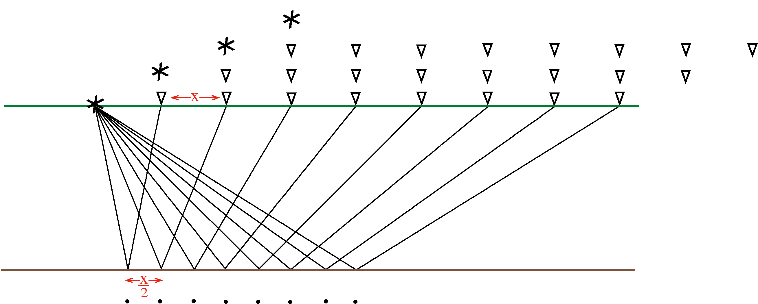
2D Survey geometry
The “roll-along” method is an efficient way to acquire seismic reflection
data that is very amenable to stacking:

Slide 8
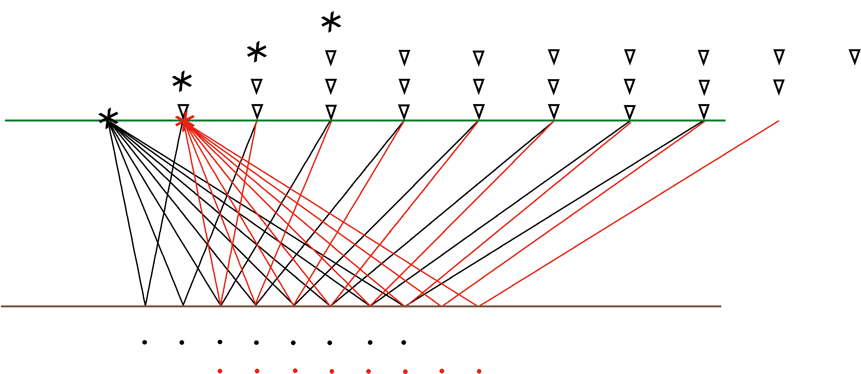
2D Survey geometry
The “roll-along” method is an efficient way to acquire seismic reflection
data that is very amenable to stacking:

Slide 9
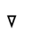
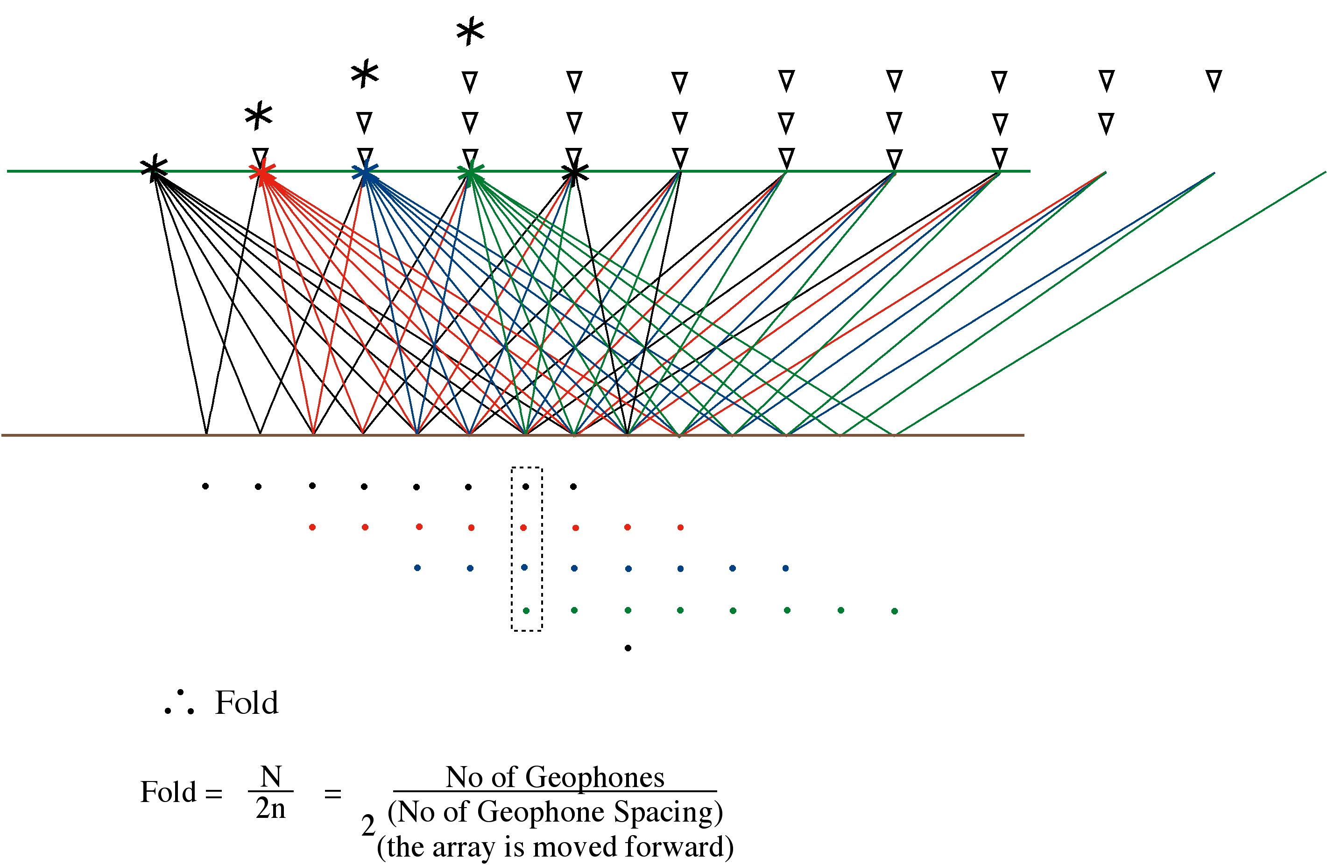
2D Survey geometry
The “roll-along” method is an efficient way to acquire seismic reflection data that is very amenable to stacking:
4 fold
CMP/CDP profiling

Slide 10
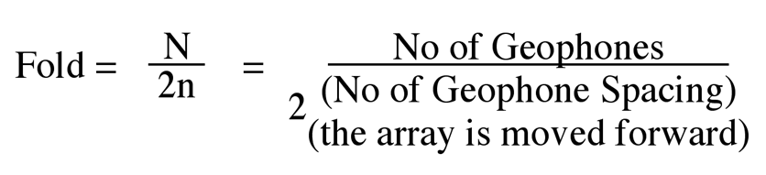
2D Survey geometry
The “roll-along” method is an efficient way to acquire seismic reflection data that is very amenable to stacking:
Common depth point profiling
4 fold
CMP/CDP profiling

Slide 11
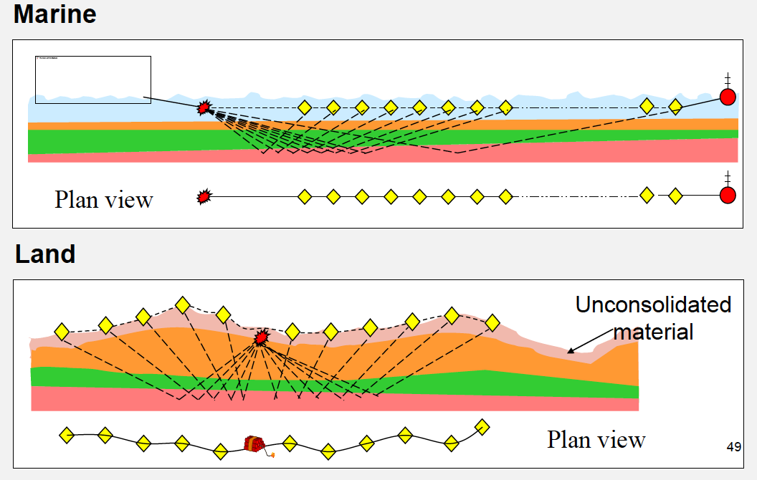
Survey design
Wang,
pers comm

Slide 12
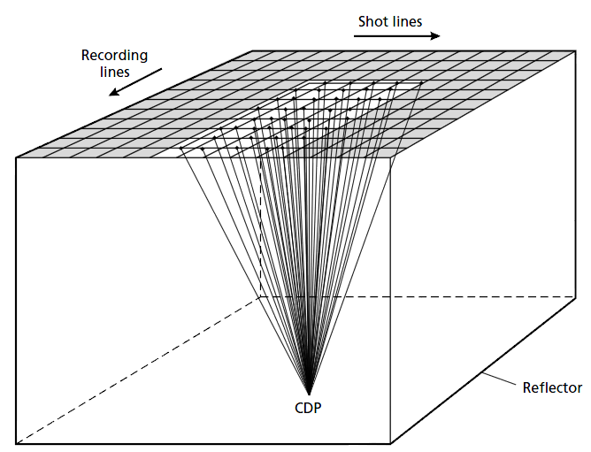
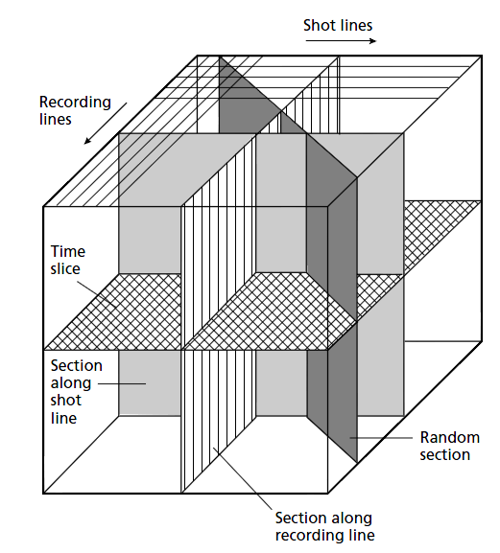
3D Survey geometry
In 3D, a Common Depth Point is sampled by
ray paths from an areal (rather than linear)
distribution of sources and receivers

Slide 13

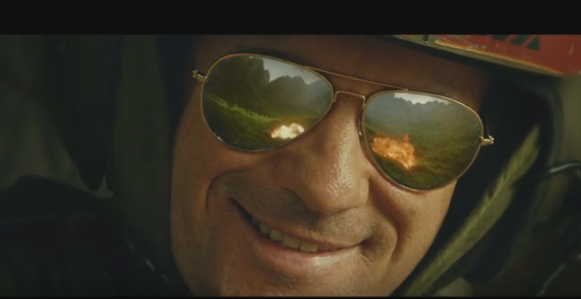
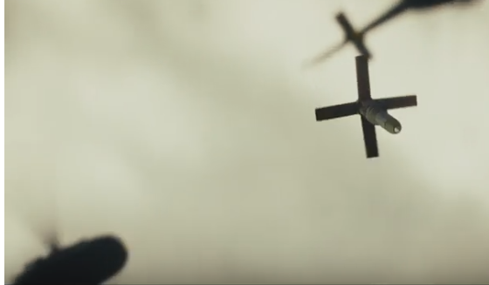
Sources: what we do not do…
https://www.youtube.com/watch?v=UiNhC9K7KjQ

Slide 14
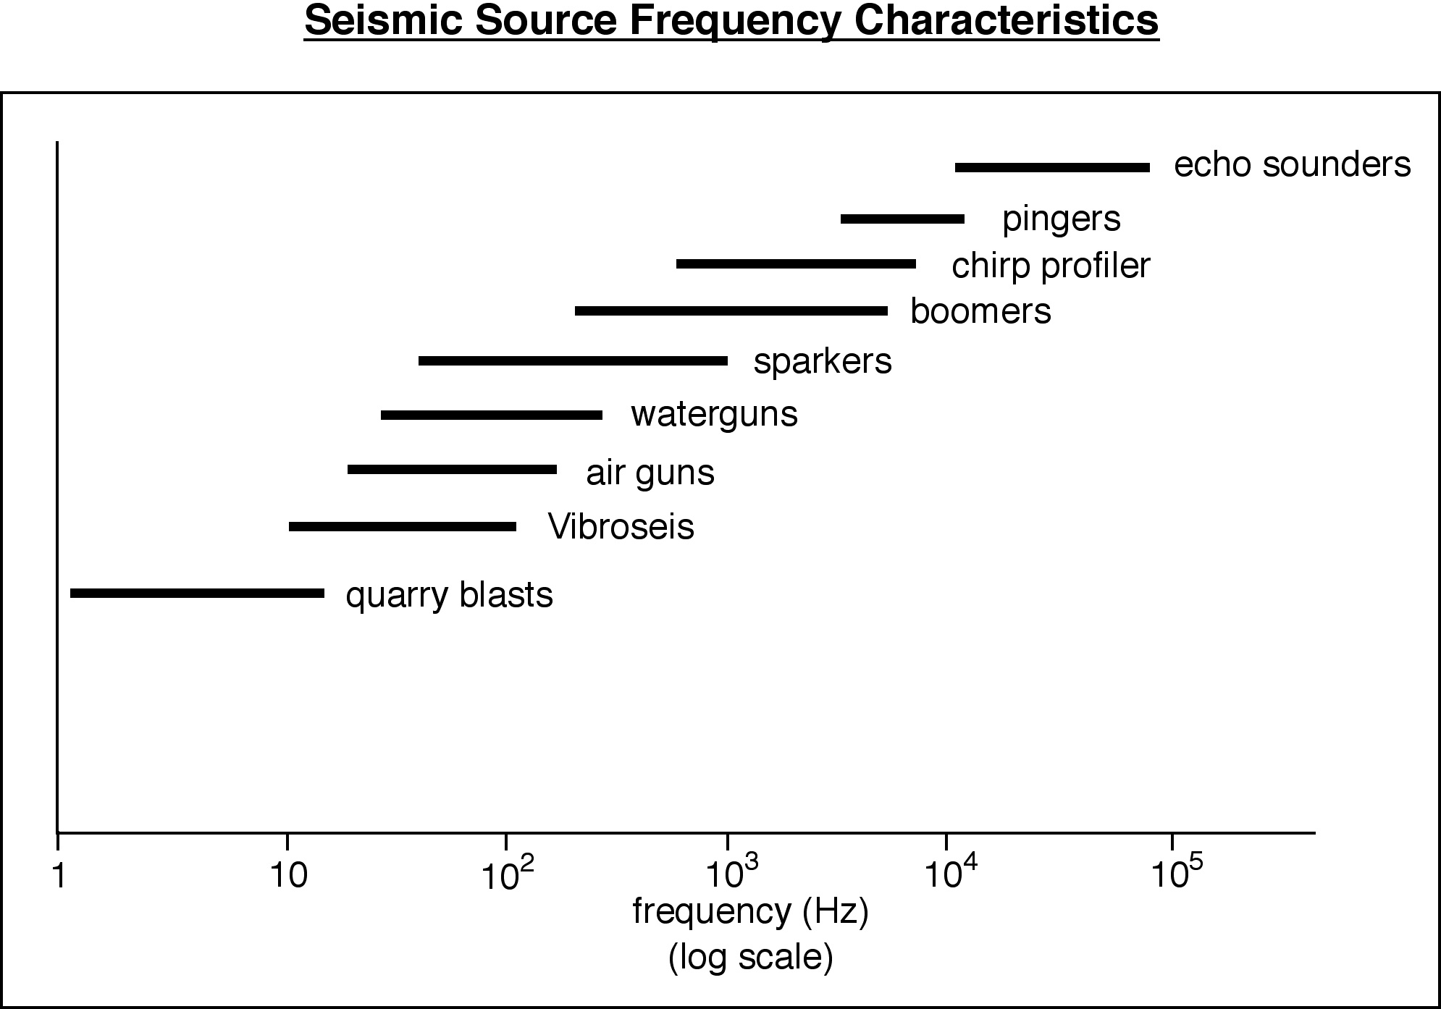
Seismic Sources
MARINE
Consider the depth to your target of interest
and the resolution you need
LAND
Kearey, Brooks & Hill.
An introduction to
Geophysical Exploration

Slide 15
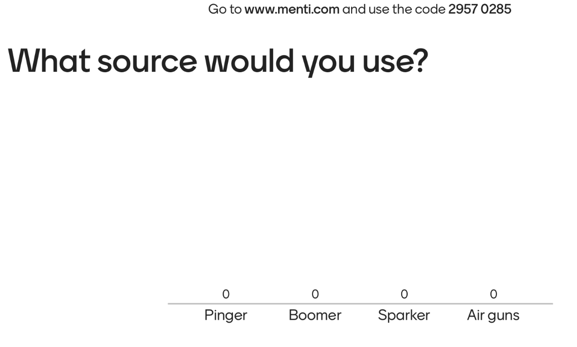


You would like to image marine shallow sedimentary
layers <0.5 m thick, in an area with P-wave velocity of 2.4km/s
What source will you use?
V = fλ

Slide 16
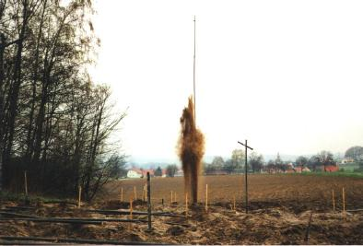
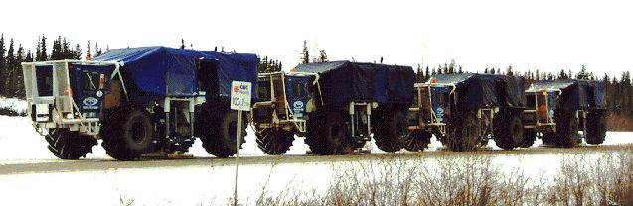
Land sources
Dynamite
Vibroseis
To get a good seismic signal detonated in bedrock beneath the weathered layer.
Truck mounted vibrator coupled to land surface and a train of seismic waves over 3 – 6 seconds produced
Advantages
Wide frequency range, High energy Choice of shot depth, High data quality, All terrain
Quick and cheap (comparatively), As much energy as you want – simply add more trucks!, Source wavelet known
Disadvantages
Damage and permit problems, Cost ~50% more than Vibroseis sources, can have difficult drill conditions, Variable source signature
Frequency content limited to 10 – 80 Hz, A lot of land needs to be cleared, only used on relatively flat ground

Slide 17
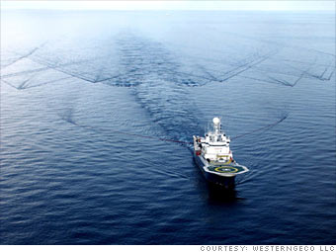
Marine sources
Low frequency sources:
Airguns – penetrate up to 15 km (if air gun array)
Waterguns – up to a few km
High frequency sources:
Sparkers – up to around 2 km
Boomers – around 1 km
Chirp profiles – few 10’s m
Pingers – few m to couple of 10’s m
Depth of penetration will depend on properties
of the sediments

Slide 18
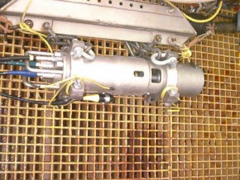
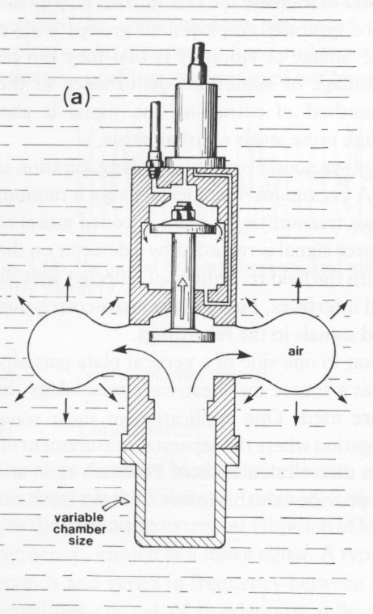
Airguns (15 – 400 Hz)
Pneumatic source in which a chamber is filled from a compressor.
Rapid decompression of this chamber forms a large, expanding air bubble, which generates a pressure wave.
From Kearey, Brooks and Hill, 2002.

Slide 19
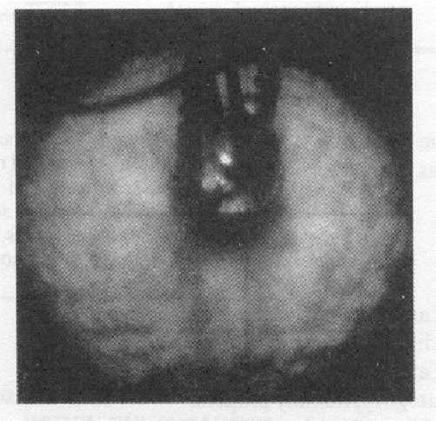
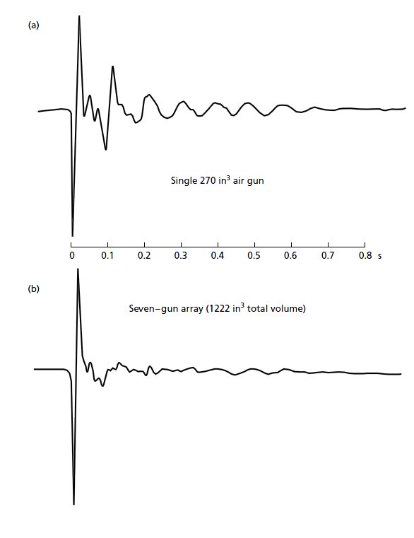
Airguns (15 – 400 Hz)
Air gun bubble:
http://www.youtube.com/watch?v=WpblB3xToZ4
Source wavelet
1. Air bubble from airgun expands until pressure of surrounding water overcomes its expansion, and forces it to contract
2. Bubble then collapses, compressing the air until the air pressure exceeds the water pressure, and the bubble can expand again
3. Expansion and collapse continues as bubble rises to surface, giving oscillatory signal characteristic of single airgun.
Single Airgun
7 Airguns

Slide 20
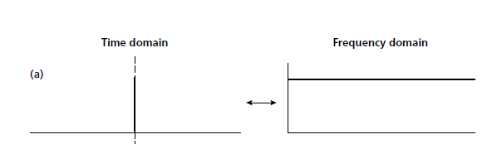
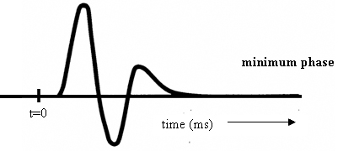
Aside: The ‘ideal’ wavelet
An ideal seismic source would be a spike and it would be repeatable
Provides the highest temporal resolution – no matter how closely spaced two reflectors are they could still be resolved
Maximum amplitude at every frequency
Amplitude
Time
Frequency
The “Minimum-phase” wavelet is the closest we can get to the ideal wavelet during seismic acquisition.
Minimum-phase wavelet has zero amplitude at t=0, and maximum amplitude a short time later
During acquisition a more ideal minimum-phase wavelet can be produced by air-gun tuning

Slide 21
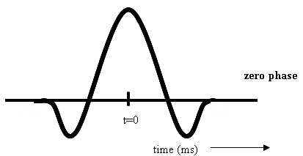
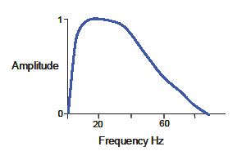
Aside: The ‘ideal’ wavelet
For interpretation purposes it would be more useful if the maximum energy of the
wavelet occurred at t=0, so a reflection from a horizon would be represented by a
peak or a trough rather than a point of zero amplitude.
The Ricker wavelet is “zero-phase”, it’s max amplitude occurs at t=0. It is impossible to create during acquisition, but we can convert a minimum-phase input wavelet into a Ricker wavelet during seismic processing
A Wiener filter is a filter designed to shape a wavelet (e.g. Minimum-phase) into another wavelet (eg. Zero-phase). Requires that the source wavelet shape is known. This process is called DECONVOLUTION (reverse of convolution)
Dominant frequency
AMPLITUDE
SPECTRA
(Frequency domain)
Recommended reading:
Phase, polarity and the interpreter’s wavelet
Simm & White, First Break v20, 2002

Slide 22
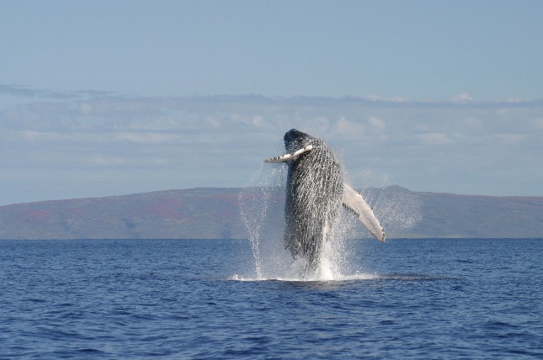
Airgun environmental considerations
Airguns have highest energy at relatively low frequencies of 10-200 Hz, this overlaps with the frequency of sound produced by whales in particular
There is concern of the impact of airguns on marine mammals including 1) physical injury (e.g. hearing loss), 2) stress, 3) masking echolocation signals and having behavioral impacts
Airgun surveys employ a range of mitigation measures including 1) “ramping up” the airgun arrays, 2) having marine mammal observers to locate mammals and stop airguns, 3) design of surveys to avoid particular areas/times
http://cms.iucn.org
Weir and Dolman 2007, Journal of
International Wildlife Law and Policy

Slide 23
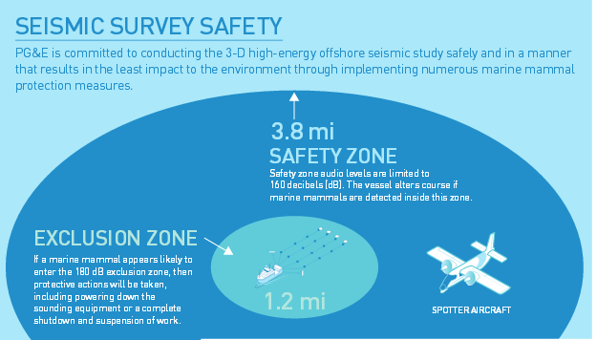
Airgun environmental considerations
http://www.pge.com
http://www.ga.gov.au/about/projects/marine/marine-seismic-surveys-and-the-environment

Slide 24
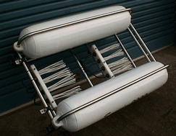

Sparkers (0.1 – 2.0 kHz)
Comprises many electrodes mounted on a single frame.
By discharging across these electrode we vaporize the surrounding sea water, producing a rapidly expanding plasma bubble.
Similar to airguns this produces our sound source.

Slide 25
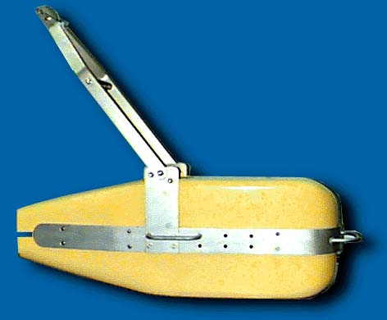
Pinger (commonly 3.5 kHz)
Generate the acoustic source by passing electrical energy through a piezoelectric crystal.
This causes the crystal to physically deform and thereby generate pressure wave.
Crystal acts as a transceiver, i.e., receives reflected energy as well.
Piezoelectricity (also called the piezoelectric effect) is the appearance of an electrical potential (a voltage, in other words) across the sides of a crystal when you subject it to mechanical stress (by squeezing it).

Slide 26
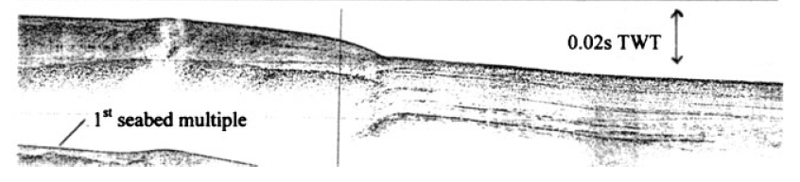
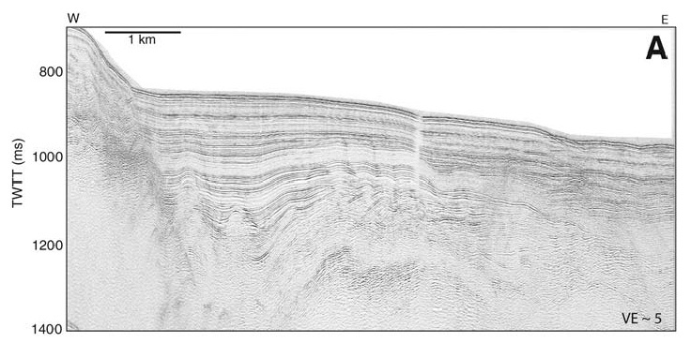
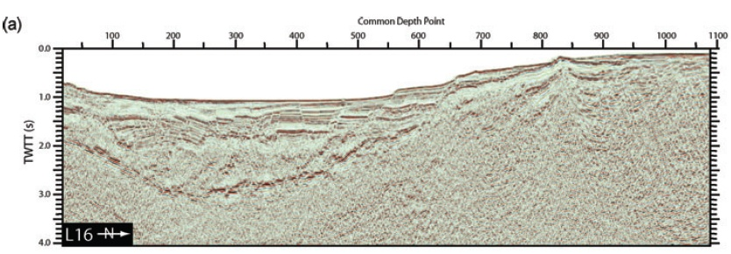
Marine source data comparison
Pinger
~17 m
~150 m
Sparker
~ 1.25 km
Airgun

Slide 27
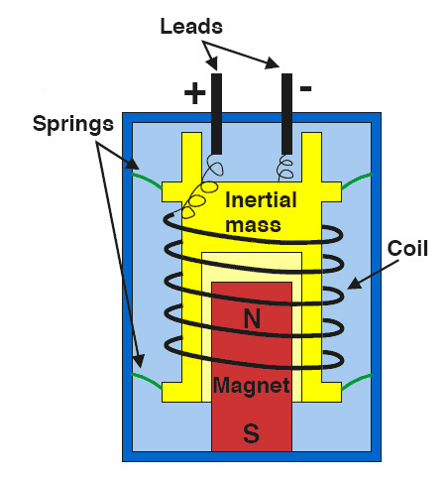
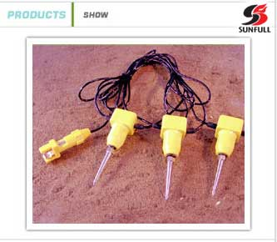
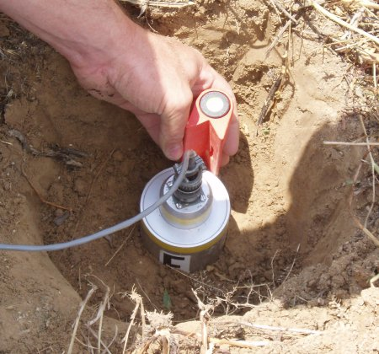
Land receivers- Geophones
A geophone converts seismic energy (vibrations) into electrical voltage
which can be accurately measured
Geophones are fixed by a spike in soft ground or mounted firmly on hard
ground
The geophone moves with the ground during the passage of a seismic wave.
There is relative motion between a suspended coil and a magnet attached to
the geophone outer body, which generates a voltage across the terminals
http://www.linearcollider.org/newsline/images/2007

Slide 28
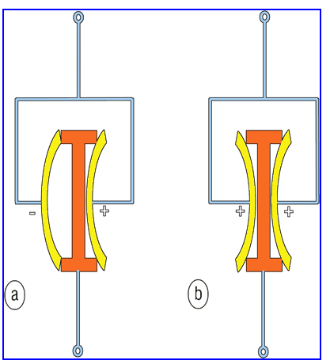
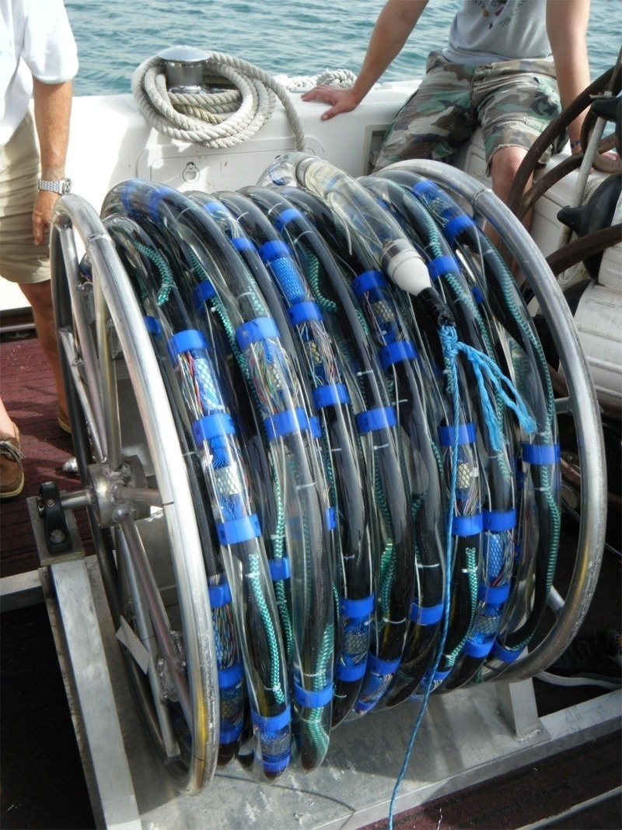
Marine receivers - Hydrophones
Dragoset et al. 2005
Piezoelectric crystals
Recommended reading:
A historical reflection on reflections,
Dragoset, Leading Edge, v24, 2005

Slide 29
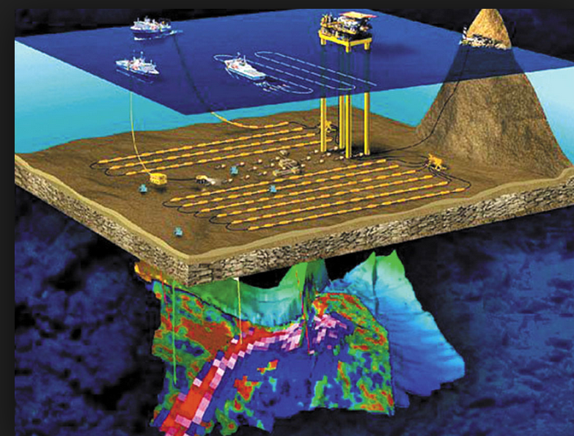
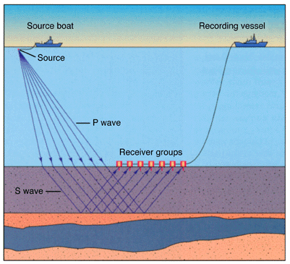
The future? - Ocean Bottom Seismic
Ocean bottom cables (OBC)

Slide 30
Learning outcomes
By the end of this lecture your should:
Understand why we need to use common depth point profiling methods to collect high-quality seismic data
2) Appreciate what sources are available and in what situation you would use different types of source
Thanks to: Yanghua Wang, Jenny Collier, Lidia Lonergan, Jo Morgan from Imperial College London, Chris Jackson from
the University of Manchester and Mark Vardy from SAND Geophysics for contributing material for this lecture series

